Slide 1
be a positive influence on others and withstand negative peer pressure

Slide 2
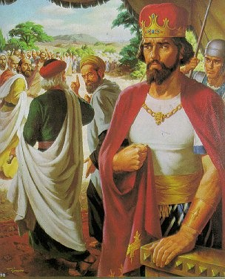
Rehoboam
“Lesson 32: Rehoboam,” Primary 6: Old Testament, (1996),140

Slide 3
Today’s lesson can be summed up in two words.
_ _ _ _
_ _ _ _ _ _ _ _

Slide 4
Can you figure out what the two words are? I’ll write your guesses on the board!
_ _ _ _
_ _ _ _ _ _ _ _

Slide 5
p e e r
p r e s s u r e
_ _ _ _
_ _ _ _ _ _ _ _
What does it mean?

Slide 6

Peer pressure is the influence you and your friends have on one another.
How can peer pressure be negative or positive?

Slide 7
In this lesson we will learn about a king who was influenced by negative peer pressure and the consequences he suffered as a result of his decisions.

Slide 8
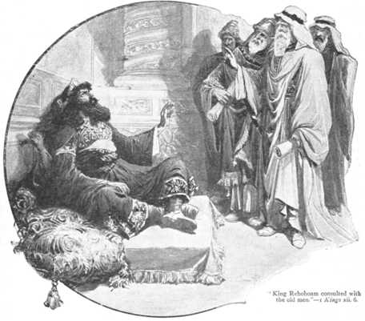
Rehoboam

Slide 9
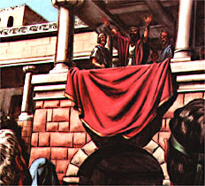
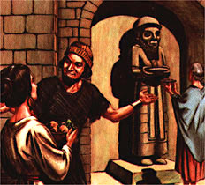
Solomon was the king of Israel for a long time. He obeyed God for many years.
Solomon had many wives. Some of his wives did not believe in God. They worshiped idols.

Slide 10
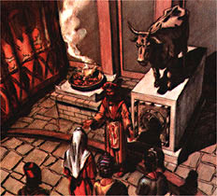
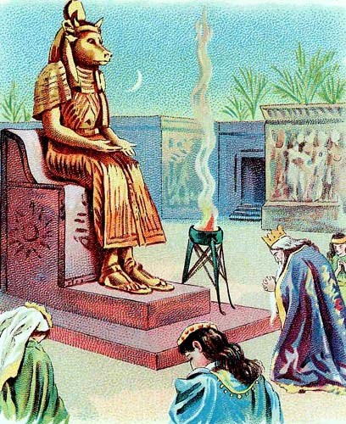
When Solomon was old, his wives wanted him to worship their idols. He forgot God.
Solomon did the wrong thing. He made sacrifices to the idols. God was angry at him.

Slide 11
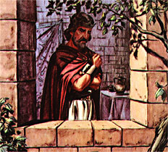
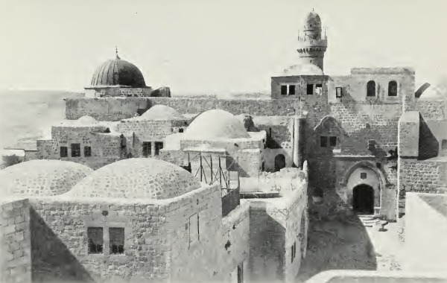
God said Solomon’s kingdom would be divided after he died.
When Solomon died he was buried near his father, David.

Slide 12
After Solomon died, his son Rehoboam became king.
He was not a good king. He was mean to the people.

Slide 13
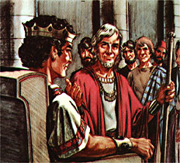
He ignored the counsel of his older advisors. They had been advisors to his father, Solomon.
The older advisors told Rehoboam the people were not happy because his father had made them pay very high taxes.

Slide 14
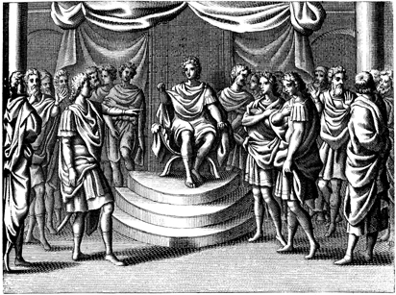
Rehoboam listened to the advice of young men he had grown up with instead.
He told the people he would make their taxes even higher.

Slide 15
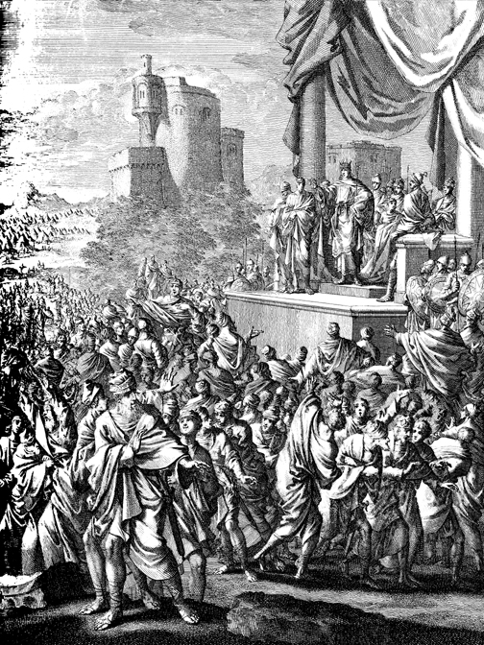
Ten of the twelve tribes of Israel revolted against Rehoboam.
They left the land of Judah and went to the lands in the north. A rebel leader named Jeroboam became their king.

Slide 16
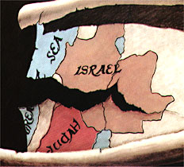
The south part of the land was called the Kingdom of Judah. Two Israelite tribes lived there. They were called Jews.
The north part of the land was called the Kingdom of Israel. The ten Israelite tribes lived there.

Slide 17
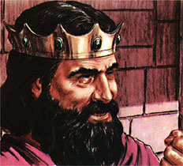
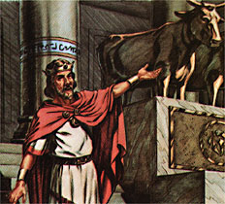
Jeroboam was strong and brave, but he was not a good king.
Jeroboam made golden idols and burned sacrifices to them. He told the people to worship the idols.

Slide 18
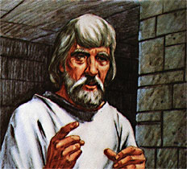
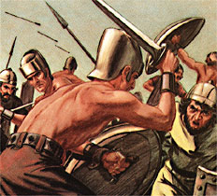
A prophet of God told Jeroboam to repent. But Jeroboam would not repent.
Jeroboam and Rehoboam had armies. They fought each other for many years.

Slide 19
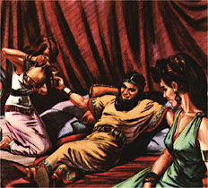
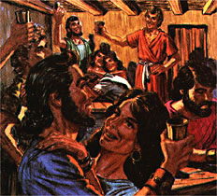
Jeroboam and Rehoboam were wicked kings. They did not teach the people to obey God.
The Israelites became wicked like their kings.

Slide 20
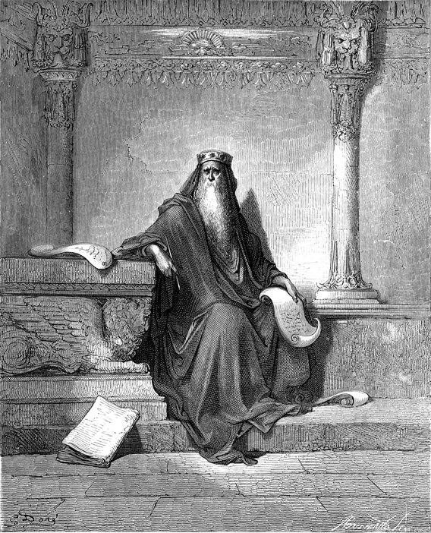
Who was Rehoboam’s father?
Let’s read 1 Kings 11:43
After Solomon died and Rehoboam became king, what did the people want him to do for them?
Let’s read 1 Kings 12:3–4

Slide 21
Whom did Rehoboam first consult with?
Let’s read 1 Kings 12:6
What was their advice to Rehoboam?
Let’s read 1 Kings 12:7

Slide 22
Why do you think this was good advice?
What could we learn from this advice about how we should treat our families, friends, and neighbors?

Slide 23
Whom did Rehoboam consult with next?
Let’s read 1 Kings 12:8–9
What was their advice to Rehoboam?
Let’s read 1 Kings 12:10–11

Slide 24
The reference to scorpions in verse 11 alludes to whips made of several thongs of leather with metal barbs embedded in the ends.

Slide 25
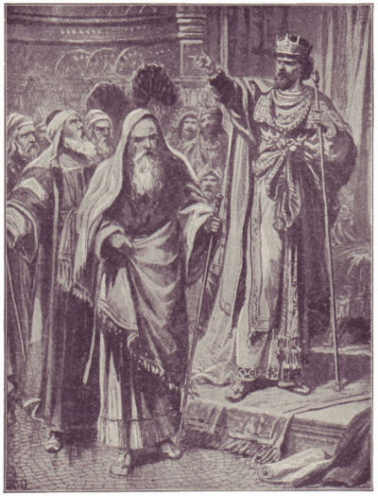
How did Rehoboam respond when the people came to him to get his answer?
Let’s read 1 Kings 12:13–14

Slide 26
Why do you think Rehoboam decided to follow the advice of the younger men rather than the older men?
How do you think the people felt about Rehoboam’s decision?

Slide 27
What are some of the consequences of being unkind to others?
What was the result of Rehoboam following the advice of his young friends instead of the wiser old men?
Let’s read 1 Kings 12:19–21
Because Rehoboam followed unwise advice, only the tribes of Judah and Benjamin accepted him as their king.

Slide 28
Jeroboam led a revolt against Rehoboam and became king of the other ten tribes.
This is how the twelve tribes of Israel became divided into two kingdoms, the kingdom of Judah (Rehoboam) and the kingdom of Israel (Jeroboam).
Note: Although the names Rehoboam and Jeroboam are similar, the two men were not brothers nor related.

Slide 29
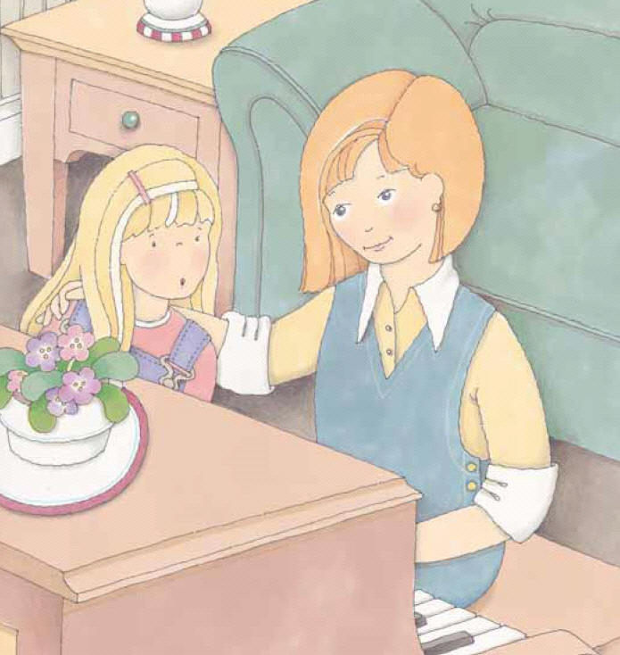
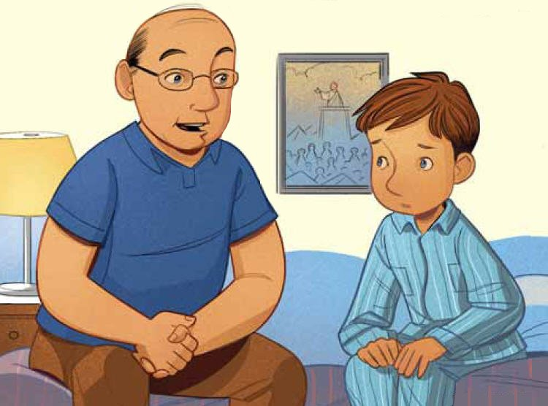
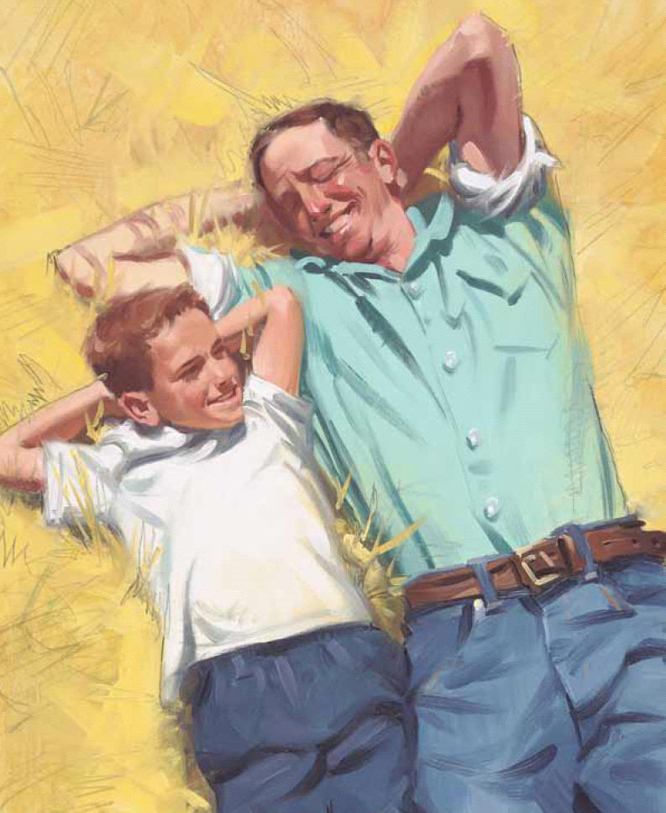
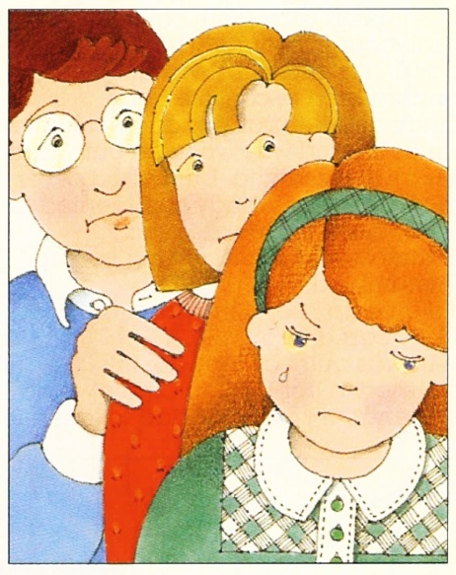
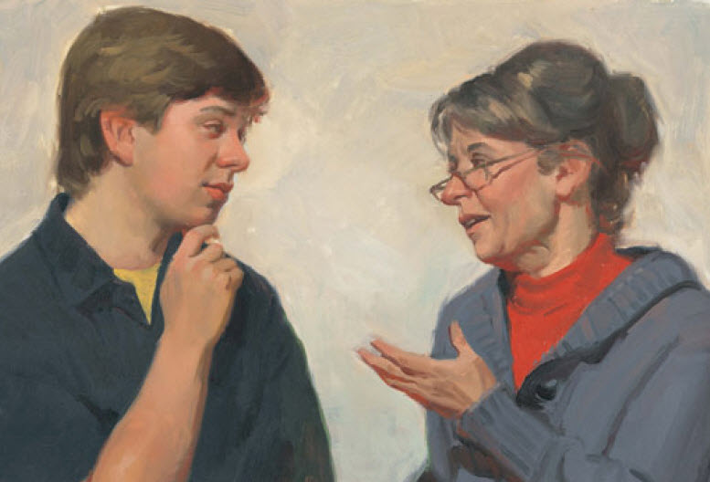
Why should we seek counsel from wise people?

Slide 30
I’ve invited someone to join our class who has a special skill or talent to share with us.
Who would you seek help from if you wanted to learn a new skill?
Enrichment Activity #3

Slide 31
It is important to seek help and following the advice of those who have the knowledge and experience to guide us.
Name people you could ask for advice about:
a. Problems in your family.
b. Something a friend is doing that is wrong.
c. How to improve your grades in school.
d. How to overcome a bad habit.
Enrichment Activity #3

Slide 32
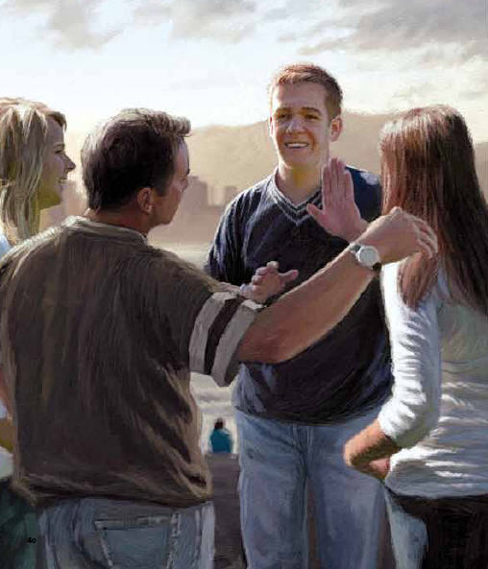
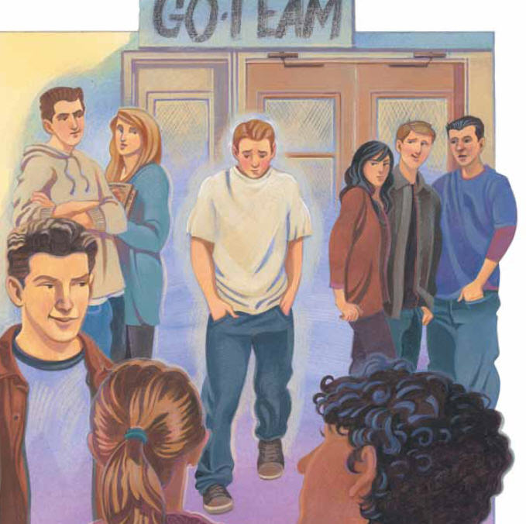
We should always ask Heavenly Father to help us with our decisions and problems.
He will help us know what to do or whom to go to for help and advice.
Why is it important to choose friends with wholesome values?

Slide 33
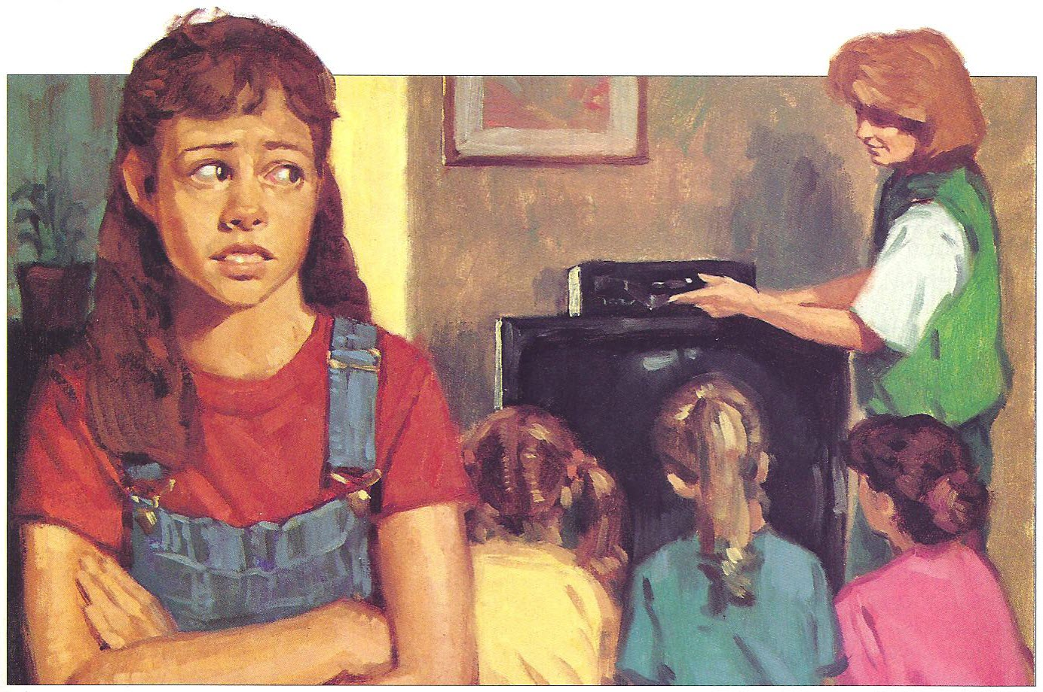
At times we don’t know if we should do something that someone is putting pressure on us to do.
Let’s read Moroni 7:13
Enrichment Activity #4

Slide 34
What would you do in the following situations?

Slide 35
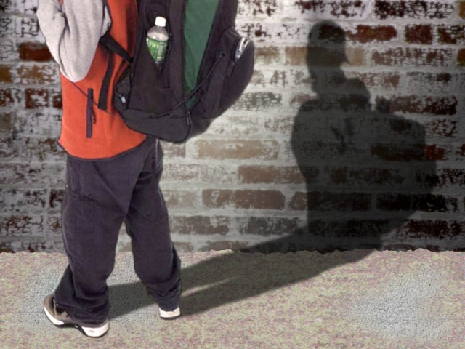
a. You have a friend who often asks you to skip school and spend the day playing.
How could you be a positive influence on your friend?
Enrichment Activity #4

Slide 36
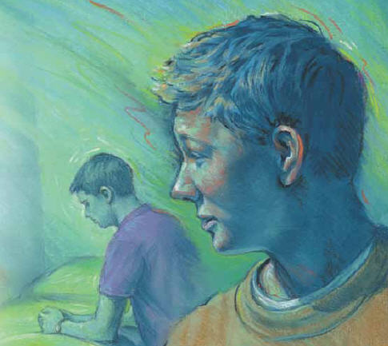
b. You are staying the night at a friend’s house. Every night before getting into bed you kneel down and say your prayers, but you know your friend does not have that habit.
What could you do when it is time to say your prayers?
Enrichment Activity #4

Slide 37
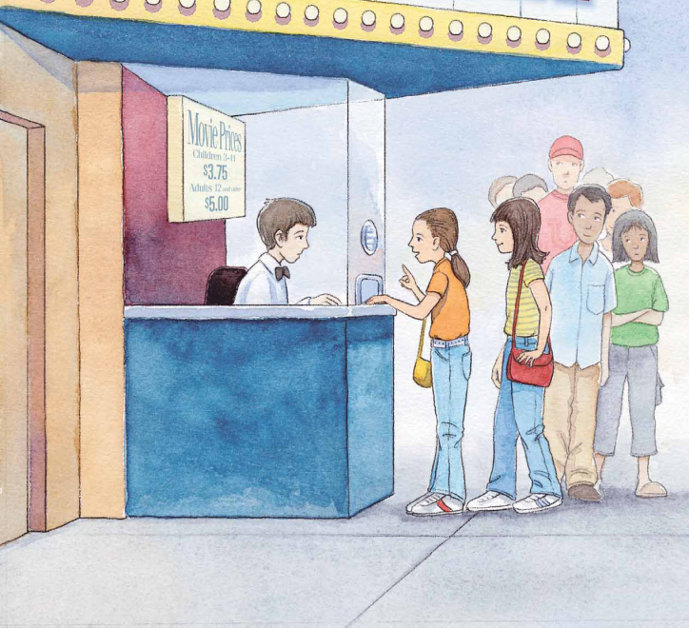
c. A group of your friends wants you to go to a movie with them. You know that your parents consider the movie to be inappropriate, but your friends beg you to go.
How could you be a positive influence on your friends?
Enrichment Activity #4

Slide 38
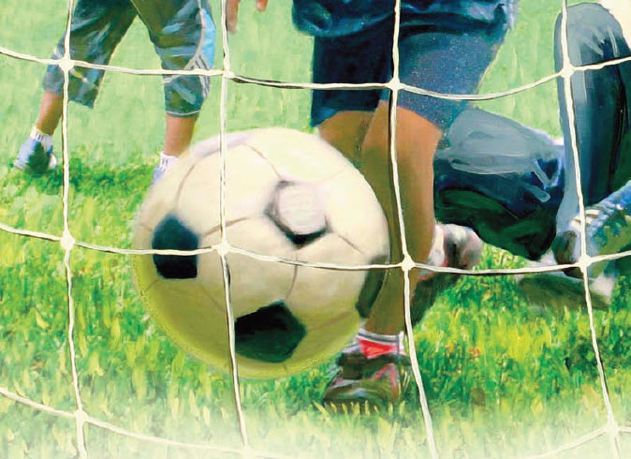
d. You want to go to church on Sundays, but some friends want you to stay home and play soccer with them.
How could you be a positive influence on your friends?
Enrichment Activity #4

Slide 39
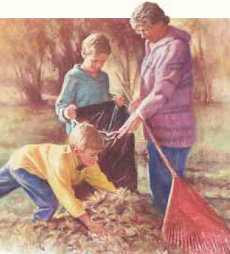
e. You have a friend who wants you to go with her to help a widow who lives down the street. You would rather play.
What should you do?
Why?
Enrichment Activity #4

Slide 40
Share experiences you have had or have observed when someone’s example has influenced others for good.
Each of you can be a positive influence on others in many ways.
Enrichment Activity #1

Slide 41

What should we do if someone tries to persuade us to do something we know is wrong?
How does negative peer pressure have a bad influence on some young people today?

Slide 42
How can we benefit from positive peer pressure?
How can we use positive peer pressure to help other young people?

Slide 43
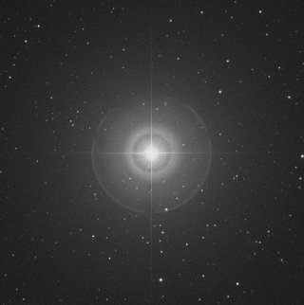
In the Northern Hemisphere (north of the equator) there is a star called the North Star.
It has been a guide to sailors, campers, and explorers throughout the ages. The direction north can always be located by means of this star.
Enrichment Activity #2

Slide 44
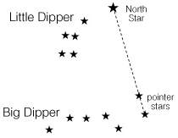
The North Star can be found by finding the Big Dipper, a group of seven stars shaped like a pan with a handle.
If a line is drawn through the two pointer stars of the Big Dipper, the two farthest stars from the handle, the line points to the North Star. The North Star is also the last star in the handle of the Little Dipper.
Enrichment Activity #2

Slide 45
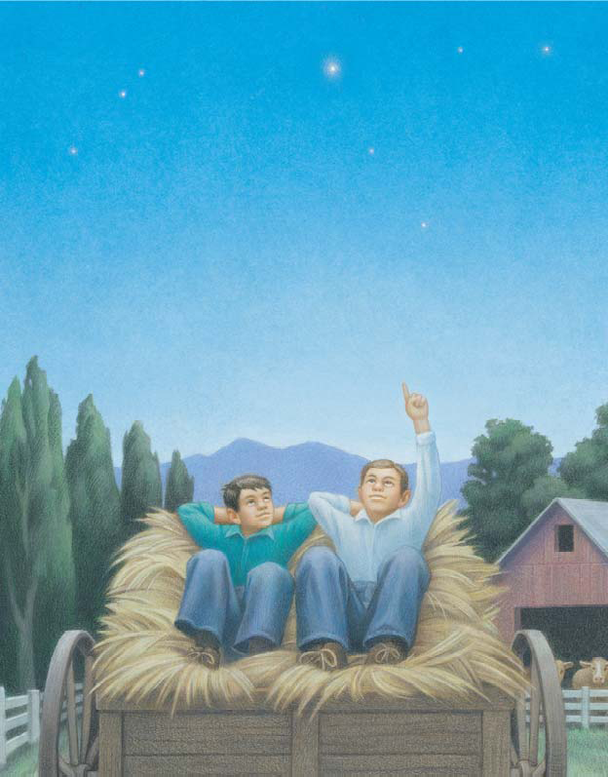
This story is about when President Gordon B. Hinckley relied on the North Star for comfort and consistency.
“After a day of good, hard labor, my younger brother Sherm and I would sleep out under the stars in the box of an old farm wagon…
Enrichment Activity #2

Slide 46
“We could identify some of the constellations and other stars. [O]ur favorite was the North Star.
“Each night, like many generations of boys before us, we would trace the Big Dipper, down the handle and out past the cup, to find the North Star…
Enrichment Activity #2

Slide 47
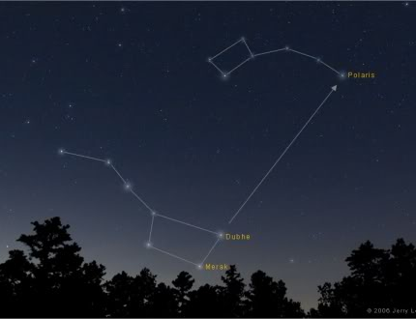
“We came to know of the constancy of that star.
“As the earth turned, the others appeared to move through the night. But the North Star held its position in line with the axis of the earth…
Enrichment Activity #2

Slide 48
“Because of those boyhood musings, the polar star came to mean something to me. I recognized it as a constant in the midst of change.
“It was something that could always be counted on, something that was dependable, an anchor in what otherwise appeared to me a moving and unstable firmament” (in Jeffrey R. Holland, “President Gordon B. Hinckley,” Ensign, June 1995, p. 5).
Enrichment Activity #2

Slide 49
How can we be constant like the North Star?
If we decide now that when we face temptations or peer pressure we will choose the right, we will be constant in making righteous decisions and others will look to us for direction.
Our decisions will not be affected by fear of what people will think of us or by negative pressure from others.
Enrichment Activity #2

Slide 50
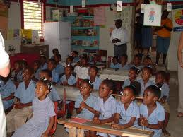
Story Time
“One day in my fourth-grade religion class in Jamaica, my teacher asked all the students to tell about their religious beliefs.
“Since I was the only Mormon in my prep school, I was chosen as the Mormon representative…
Enrichment Activity #5

Slide 51
“By the time it was my turn, my heart was beating a hundred miles a minute.
“I was never much of a public speaker anyway, and I didn’t have a loud voice.
“When I stood up, I just stared at the sea of eyes before me and tried to speak about some of our beliefs…
Enrichment Activity #5

Slide 52
“I first spoke about the Word of Wisdom, then talked about the sacrament, about how we used bread and water to represent the Savior's body and blood when he died for us.
“Before I could say another word, everyone started laughing at me…
Enrichment Activity #5

Slide 53
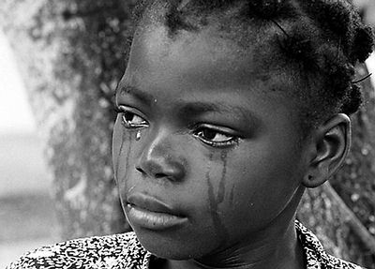
“Tears stung my eyes as I wondered what I had said to make them laugh.
“I quickly wiped my eyes and went to my seat amidst the chants of ‘Bread and water, bread and water.’
“By the end of the day I was still being teased…
Enrichment Activity #5

Slide 54

“I still don’t know why they decided to make fun of what I was saying.
“When I got home, I took my mother’s huge Bible off the shelf and began looking at some of the pictures.
“As I was flipping a page, I glimpsed a scripture and quickly turned back to it…
Enrichment Activity #5

Slide 55
“It was Matthew 10:32: ‘Whosoever therefore shall confess me before men, him will I confess also before my Father which is in heaven.’
As I read the words over and over, a feeling of peace washed over me as I realized it didn’t matter who laughed at me as long as I was doing what was right” (Camille Nugent, New Era, June 1994, p. 15).
Enrichment Activity #5

Slide 56

Dare to Do Right
1. Dare to do right! Dare to be true! You have a work that no other can do; Do it so bravely, so kindly, so well, Angels will hasten the story to tell.
Chorus Dare, dare, dare to do right; Dare, dare, dare to be true, Dare to be true, dare to be true.
2. Dare to do right! Dare to be true! Other men’s failures can never save you. Stand by your conscience, your honor, your faith; Stand like a hero and battle till death.
Words: George L. Taylor, b. 1835
Music: Arr. by A. C. Smyth, 1840–1909
Enrichment Activity #6

Slide 57
I want to always remain constant and faithful to Heavenly Father in all circumstances. I know it is important for each of us to be a positive influence and to help our friends make wise decisions.
I challenge each of you to not give in to negative peer pressure and to be a positive influence on those around you by being constant in making righteous decisions in all situations.

Slide 58
Images and clipart are from lds.org, sugardoodle.net, Microsoft Office, and other websites indicating the images were in the public domain. The hymns, scripture story and lesson are primarily from www.lds.org.
Please do not use this presentation for commercial use. Feel free to alter the presentation for use in church or home to suit personal preference.
The presentation is intended to supplement, not replace, the lesson manual or scriptures. Teachers should refer to the manual, scriptures and other resources when preparing and conducting the lesson.

